Slide 1
coursera CAPSTONE PROJECT – The Battle of Neighborhoods
Cluster Analysis of manchester Real Estate Market

Slide 2
Business problem
Manchester's housing market has been one of the most impressive in the UK for many years, and 2019 was no different. House prices rose significantly, thanks to huge population growth and lack of available stock. The latest Hometrack UK Cities House Price Index shows that property values in Manchester are growing at 3.4% annually. Not only is this higher than the national average (2.1%), it is also almost twice as fast as the UK cities average (1.8%) and almost four times higher than the annual growth in London (0.9%).

Slide 3
Business problem
How can we support Manchester homebuyers in this increasing financial scenario?

Slide 4
solution
Clustering Manchester neighborhoods in order to recommend venues and the current average price of real estate where homebuyers can make a real estate investment.

Slide 5
Data and methodology
Data
Merging data on Manchester properties and the relative price paid data from the HM Land Registry and data on amenities and essential facilities surrounding such properties from FourSquare API interface.
Mehodology
Collect Inspection Data;
Explore and Understand Data;
Data preparation and preprocessing;
Modeling

Slide 6
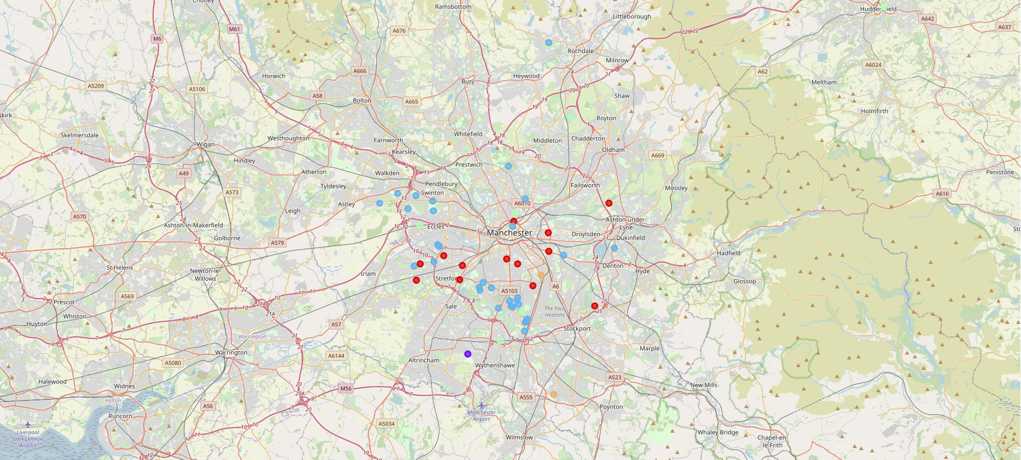
K-means clustering

Slide 7
Outcome
Examination of real estates by clusters
Clusters 0, 3 and 4 may target home buyers prone to live in 'green' areas with parks, waterfronts;
Clusters 1 and 2 may target individuals who love pubs, theatres and soccer.
Examination of real estates according to Manchester areas
Areas cover every sector, from residential to commercial, demonstrating the full-spectrum strength of the Manchester property market, and providing yet more confidence that the city’s booming economy will continue to outshine most other areas of the UK in the foreseeable future.

